Slide 1
MODULE 2 Mobile Radio Propagation: Small-Scale Fading

Slide 2
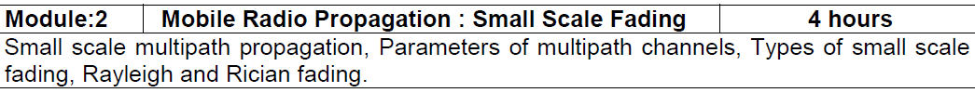

Slide 3
Large scale propagation properties of wireless systems - slowly varying properties that depend primarily on the distance between Tx and Rx.
Free space path loss
Power decay with respect to a reference point
The two-ray model
General characterization of systems using the path loss exponent.
Diffraction
Scattering
Small signal: Rapidly changing signal characteristics primarily caused by movement and multipath.

Slide 4
I. Fading
Fading: rapid fluctuations of received signal strength over short time intervals and/or travel distances
Caused by interference from multiple copies of Tx signal arriving @ Rx at slightly different times
Three most important effects:
Rapid changes in signal strengths over small travel distances or short time periods.
Changes in the frequency of signals.
Multiple signals arriving a different times. When added together at the antenna, signals are spread out in time. This can cause a smearing of the signal and interference between bits that are received.

Slide 5
Fading signals occur due to reflections from ground & surrounding buildings (clutter) as well as scattered signals from trees, people, towers, etc.
often an LOS path is not available so the first multipath signal arrival is probably the desired signal (the one which traveled the shortest distance)
allows service even when Rx is severely obstructed by surrounding clutter
Notes:
fading

Slide 6
Even stationary Tx/Rx wireless links can experience fading due to the motion of objects (cars, people, trees, etc.) in surrounding environment off of which come the reflections
Multipath signals have randomly distributed amplitudes, phases, & direction of arrival
vector summation of (A ∠θ) @ Rx of multipath leads to constructive/destructive interference as mobile Rx moves in space with respect to time
Notes:
stationary

Slide 7
received signal strength can vary by Small-scale fading over distances of a few meter (about 7 cm at 1 GHz)!
This is a variation between, say, 1 mW and 10⁻⁶ mW.
If a user stops at a deeply faded point, the signal quality can be quite bad.
However, even if a user stops, others around may still be moving and can change the fading characteristics.
And if we have another antenna, say only 7 to 10 cm separated from the other antenna, that signal could be good.
Notes:
10^ -6 mW Antenna space diversity

Slide 8
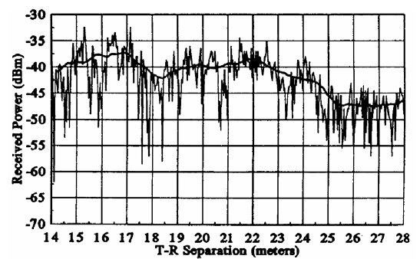
fading occurs around received signal strength predicted from large-scale path loss models

Slide 9
II. Physical Factors Influencing Fading in Mobile Radio Channel (MRC)
1) Multipath Propagation
# and strength of multipath signals
time delay of signal arrival
large path length differences → large differences in delay between signals
urban area w/ many buildings distributed over large spatial scale
large # of strong multipath signals with only a few having a large time delay
suburb with nearby office park or shopping mall
moderate # of strong multipath signals with small to moderate delay times
rural → few multipath signals (LOS + ground reflection)

Slide 10
2) Speed of Mobile
relative motion between base station & mobile causes random frequency modulation due to Doppler shift (f_{d})
Different multipath components may have different frequency shifts.
3) Speed of Surrounding Objects
also influence Doppler shifts on multipath signals
dominates small-scale fading if speed of objects > mobile speed
otherwise ignored

Slide 11
4) Tx signal bandwidth (B_{s})
The mobile radio channel (MRC) is modeled as filter w/ specific bandwidth (BW)
The relationship between the signal BW & the MRC BW will affect fading rates and distortion, and so will determine:
a) if small-scale fading is significant
b) if time distortion of signal leads to inter-symbol interference (ISI)
An MRC can cause distortion/ISI or small-scale fading, or both.
But typically one or the other.

Slide 12
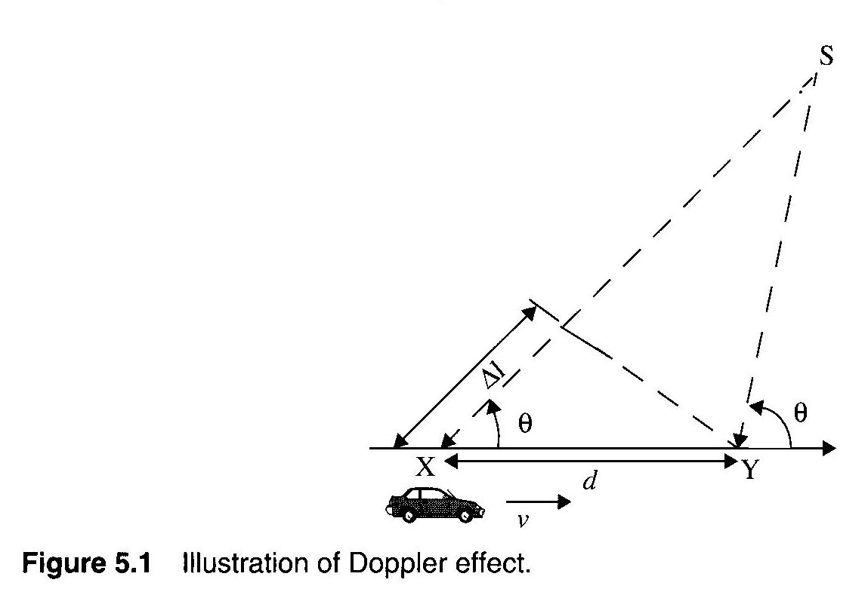
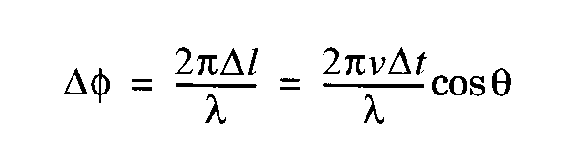
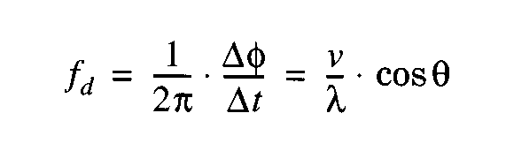
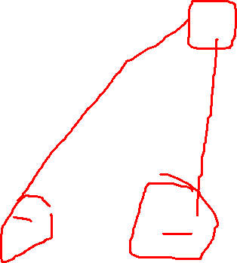
Doppler Shift
motion causes frequency modulation due to Doppler shift (f_{d})
v : velocity (m/s)
λ : wavelength (m)
θ : angle between
mobile direction
and arrival direction of RF energy
+ shift → mobile moving toward S
− shift → mobile moving away from S

Slide 13
Two Doppler shifts to consider above
1. The Doppler shift of the signal when it is received at the car.
2. The Doppler shift of the signal when it bounces off the car and is received somewhere else.
Multipath signals will have different f_{d}’s for constant v because of random arrival directions!!

Slide 14
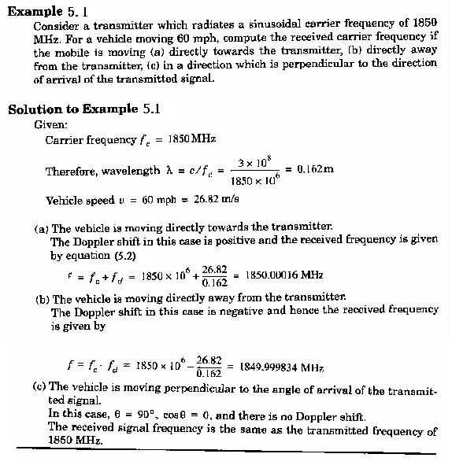

Slide 15
Note: What matters with Doppler shift is not the absolute frequency, but the shift in frequency relative to the bandwidth of a channel.
For example: A shift of 166 Hz may be significant for a channel with a 1 kHz bandwidth.
In general, low bit rate (low bandwidth) channels are affected by Doppler shift.

Slide 16
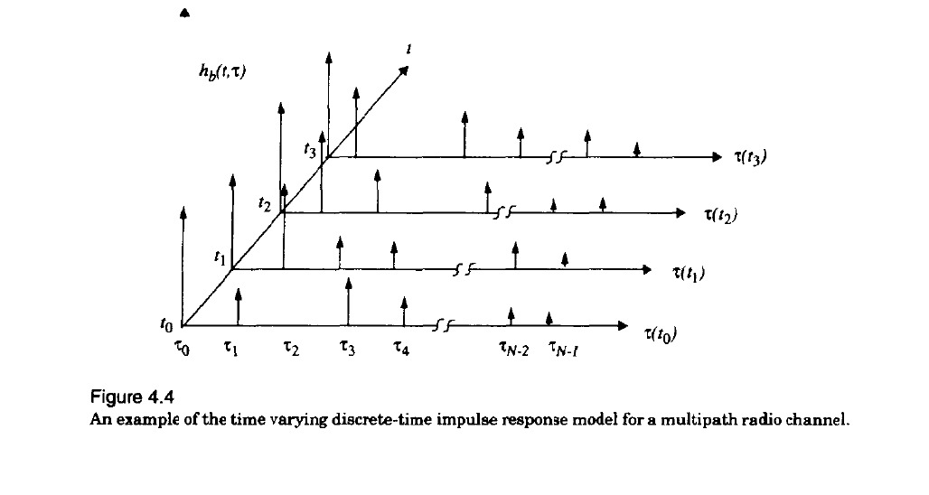
Multipath parameters

Slide 17
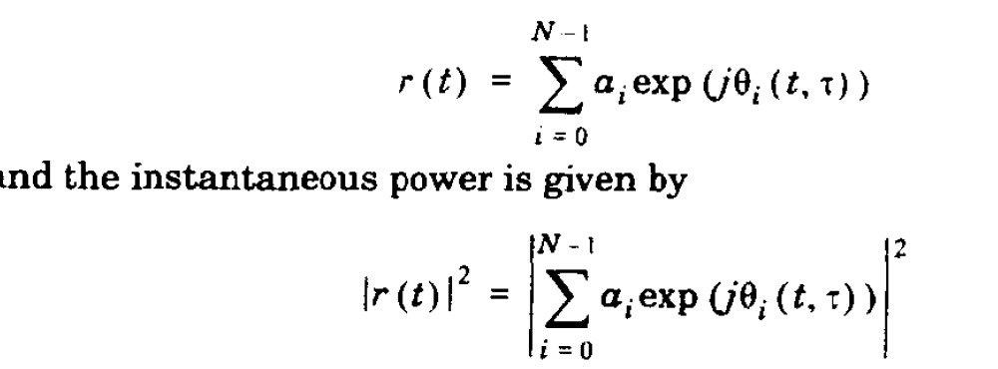
Received Signal strength

Slide 18
IV. Multipath Channel Parameters
Derived from multipath power delay profiles (Eq. 5-18)
P (τ_{k}) : relative power amplitudes of multipath signals (absolute measurements are not needed)
Relative to the first detectable signal arriving at the Rx at τ₀
use ensemble average of many profiles in a small localized area →typically 2 − 6 m spacing of measurements→ to obtain average small-scale response

Slide 19
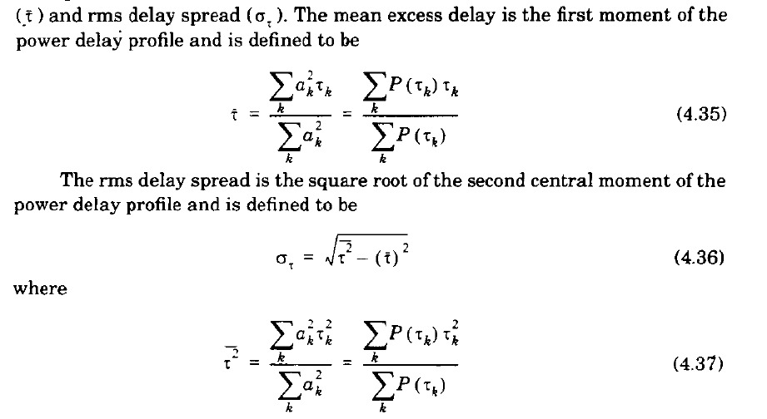
“excess delay” : all values computed relative to the time of first signal arrival τ_{o}
A simple way to explain this is “the range of time within which most of the delayed signals arrive”

Slide 20
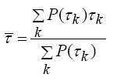
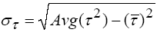
Time Dispersion Parameters
“excess delay” : all values computed relative to the time of first signal arrival τ_{o}
mean excess delay →
RMS delay spread →
where Avg( τ²) is the same computation as above as used for except that
A simple way to explain this is “the range of time within which most of the delayed signals arrive”

Slide 21
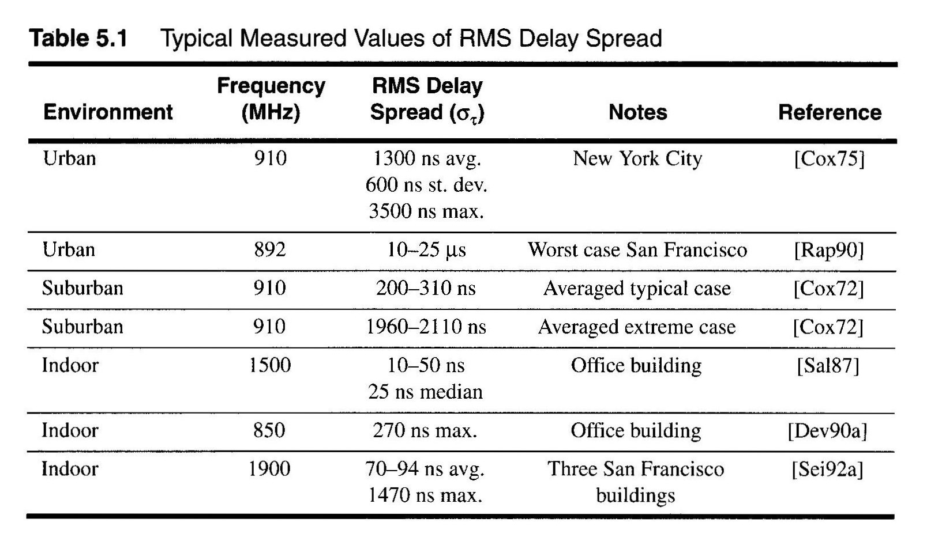
outdoor channel ~ on the order of microseconds
indoor channel ~ on the order of nanoseconds

Slide 22
Coherence BW (B_{c}) and Delay Spread ( )
The Fourier Transform of multipath delay shows frequency (spectral) characteristics of the MRC
B_{c} : statistical measure of frequency range where MRC response is flat
MRC response is flat = passes all frequencies with ≈ equal gain & linear phase
amplitudes of different frequency components are correlated
if two sinusoids have frequency separation greater than B_{c}, they are affected quite differently by the channel

Slide 23
amplitude correlation → multipath signals have close to the same amplitude → if they are then out-of-phase they have significant destructive interference with each other (deep fades)
so a flat fading channel is both “good” and “bad”
Good: The MRC is like a bandpass filter and passes signals without major attenuation from the channel.
Bad: Deep fading can occur.

Slide 24
so the coherence bandwidth is “the range of frequencies over which two frequency components have a strong potential for amplitude correlation.”

Slide 25
estimates
0.9 correlation → Bc ≈ 1 / 50 (signals are 90% correlated with each other)
0.5 correlation → Bc ≈ 1 / 5
specific channels require detailed analysis for a particular transmitted signal – these are just rough estimates

Slide 26
A channel that is not a flat fading channel is called frequency selective fading because different frequencies within a signal are attenuated differently by the MRC.
Note: The definition of flat or frequency selective fading is defined with respect to the bandwidth of the signal that is being transmitted.
B_{c} and σ_{τ} are related quantities that characterize time-varying nature of the MRC for multipath interference from frequency & time domain perspectives

Slide 27
Coherence BW (B_{c}) and Delay Spread ( ) parameters do NOT characterize the time-varying nature of the MRC due to the mobility of the mobile and/or surrounding objects
that is to say, B_{c} and characterize the statistics, (how multipath signals are formed from scattering/reflections and travel different distances)
B_{c} and σ_{τ} do not characterize the mobility of the Tx or Rx.
Notes:
Mobility, static

Slide 28
Doppler Spread (B_{D}) & Coherence Time (T_{c})
B_{D} : measure of spectral broadening of the Tx signal caused by motion → i.e., Doppler shift
B_{D} = max Doppler shift = f_{max} = v_{max} / λ
In what direction does movement occur to create this worst case?
if Tx signal bandwidth (B_{s}) is large such that B_{s} >> B_{D} then effects of Doppler spread are NOT important so Doppler spread is only important for low bps (data rate) applications (e.g. paging)

Slide 29
T_{c} : statistical measure of the time interval over which MRC impulse response remains invariant → amplitude & phase of multipath signals ≈ constant
Coherence Time (T_{c}) = passes all received signals with virtually the same characteristics because the channel has not changed
time duration over which two received signals have a strong potential for amplitude correlation
Notes:
Constant

Slide 30
Two signals arriving with a time separation greater than T_{c} are affected differently by the channel, since the channel has changed within the time interval
For digital communications coherence time and Doppler spread are related by
f_{m} – max. Doppler spread

Slide 31
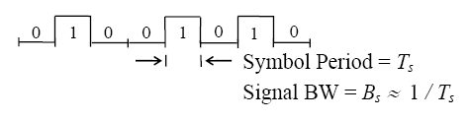
V. Types of Small-Scale Fading
Fading can be caused by two independent MRC propagation mechanisms:
1) time dispersion → multipath delay (B_{c} , )
2) frequency dispersion → Doppler spread (B_{D} , T_{c})
Important digital Tx signal parameters → symbol period & signal BW

Slide 32
A pulse can be more than two levels, however, so each period would be called a "symbol period".
We send 0 (say +1 Volt) or 1 (say -1 Volt) → one bit per “symbol”
Or we could send 10 (+3 Volts) or 00 (+1 Volt) or 01 (-1 Volt) or 11 (-3 Volts) → two bits per “symbol”

Slide 33
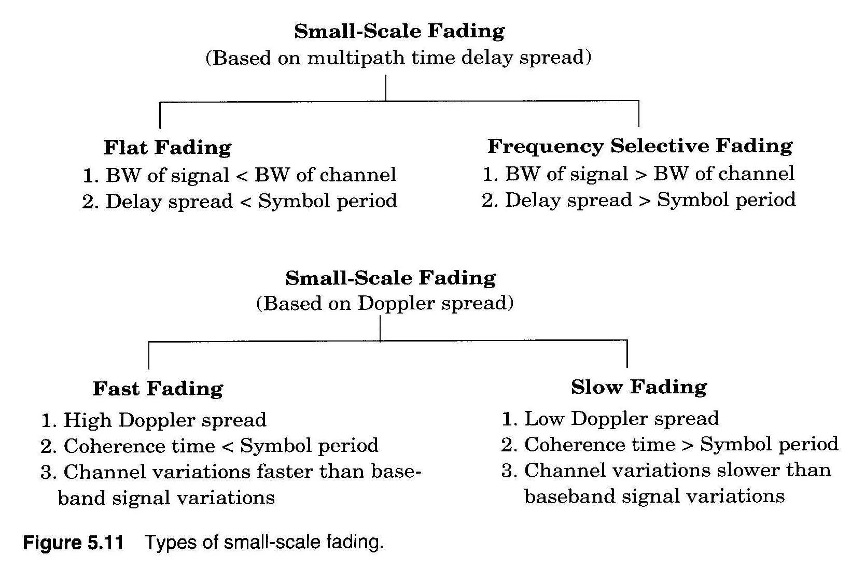

Types of small-scale fading

Slide 34
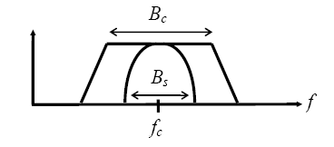
Fading due to Multipath Delay
A）Flat Fading → B_{s} << B_{c} or T_{s} >>
signal fits easily within the bandwidth of the channel
channel BW >> signal BW
most commonly occurring type of fading

Slide 35
spectral properties of Tx signal are preserved
signal is called a narrowband channel, since the bandwidth of the signal is narrow with respect to the channel bandwidth
signal is not distorted
What does T_{s} >> mean??
all multipath signals arrive at mobile Rx during 1 symbol period
∴ Little intersymbol interference occurs (no multipath components arrive late to interfere with the next symbol)

Slide 36
flat fading is generally considered desirable
Even though fading in amplitude occurs, the signal is not distorted
Forward link → can increase mobile Rx gain (automatic gain control)
Reverse link → can increase mobile Tx power (power control)
Can use diversity techniques (described in a later lecture)

Slide 37
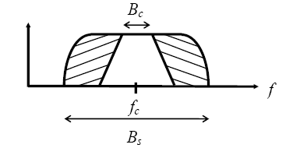
B) Frequency Selective Fading → B_{s} > B_{c} or T_{s} <
B_{s} > B_{c} → certain frequency components of the signal are attenuated much more than others

Slide 38
Ts < σ_{τ} → delayed versions of Tx signal arrive during different symbol periods
e.g. receiving an LOS → “1” & multipath “0” (from prior symbol!)
This results in intersymbol interference (ISI)
Undesirable
it is very difficult to predict mobile Rx performance with frequency selective channels

Slide 39
2) Fading due to Doppler Spread
Caused by motion of Tx and Rx and reflection sources.
A) Fast Fading → B_{s} < B_{D} or T_{s} > T_{c}
B_{s} < B_{D}
Doppler shifts significantly alter spectral BW of TX signal
signal “spreading”
Ts > Tc
MRC changes within 1 symbol period
rapid amplitude fluctuations
uncommon in most digital communication systems

Slide 40
B) Slow Fading → T_{s} << T_{c} or B_{s} >> B_{D}
MRC constant over many symbol periods
slow amplitude fluctuations
for v = 60 mph @ f_{c} = 2 GHz → B_{D} = 178 Hz
∴ B_{s} ≈ 2 kHz >> B_{D}
B_{s} almost always >> B_{D} for most applications
** NOTE: Typically use a factor of 10 to designate “>>” **

Slide 41
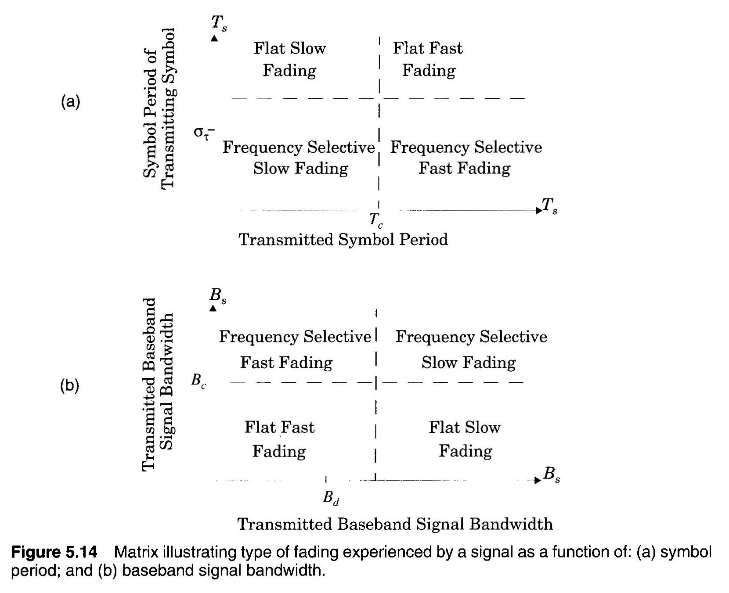
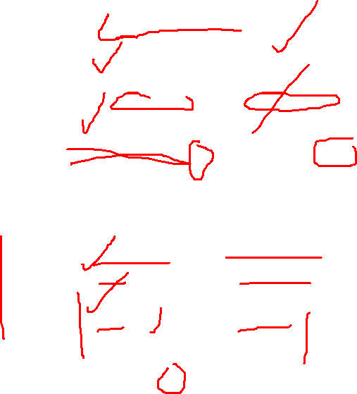

Slide 42
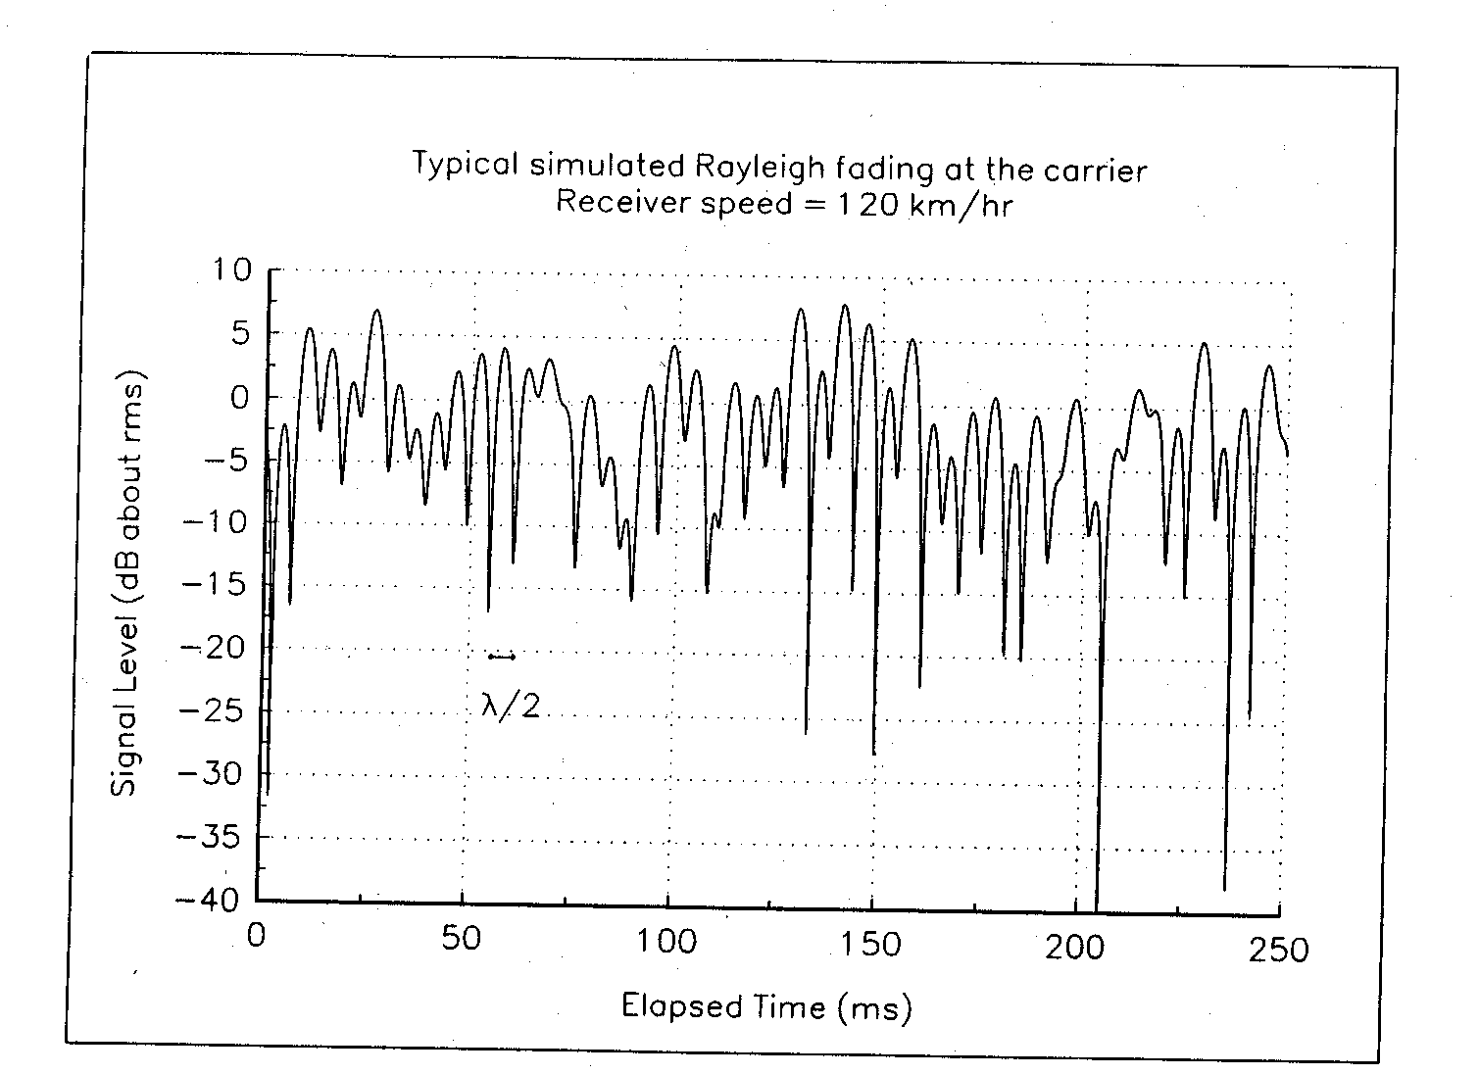
Rayleigh and Ricean Distributions
Rayleigh Fading Distribution
The sum of two quadrature Gaussian noise signals

Slide 43
Consider a carrier signal at frequency and with an amplitude
The received signal is the sum of n waves
where
define
We have

Slide 44
It can be assumed that x and y are Gaussian random variables with mean equal to zero due to the following reasons
n is usually very large.
The individual amplitude are random.
The phases have a uniform distribution.
Because x and y are independent random variables, the joint distribution p(x,y) is
The distribution can be written as a function of

Slide 45
We have
The Rayleigh distribution has a pdf given by

Slide 46
pdf of Rayleigh distribution

Slide 47
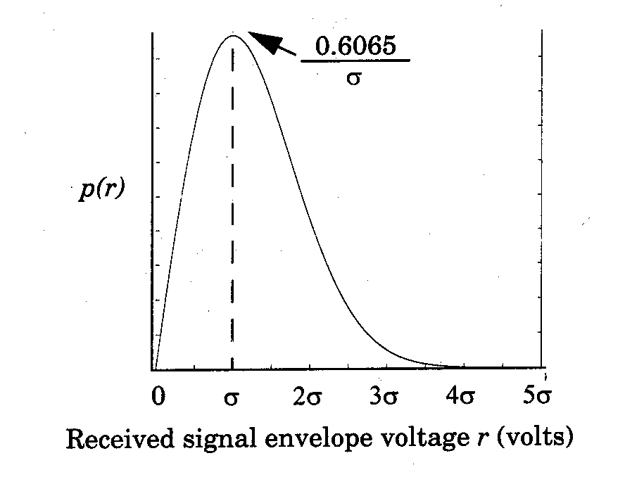

Slide 48
Cumulative distribution function (CDF)
The mean value of the Rayleigh distribution is given by
The variance of the Rayleigh distribution is given by

Slide 49
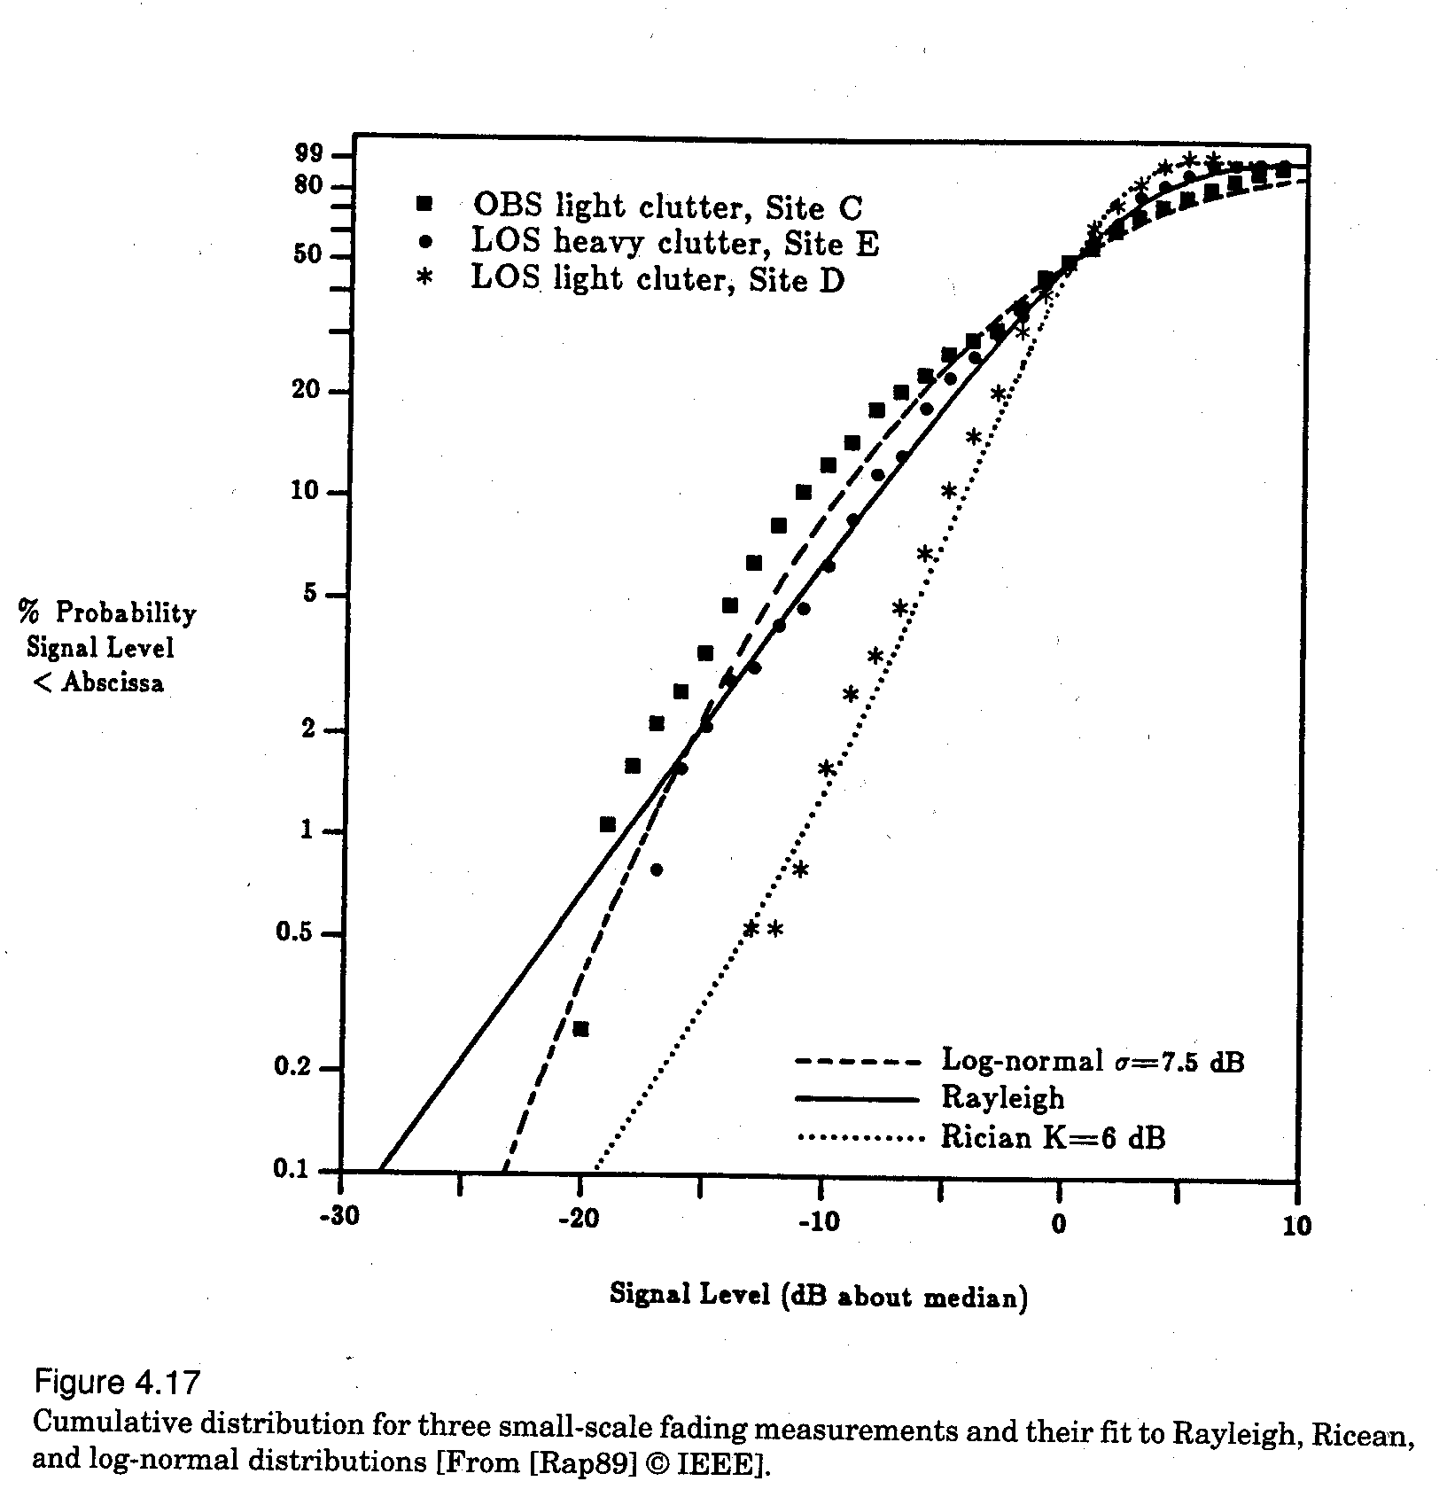

Slide 50
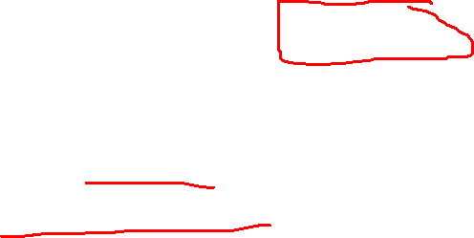
Ricean Fading Distribution: When there is a dominant stationary (non-fading) signal component present, such as a line-of-sight propagation path, the small-scale fading envelope distribution is Ricean.
Scattered waves
Direct wave

Slide 51

By following similar steps described in Rayleigh distribution, we obtain
where
is the modified Bessel function of the first kind and zero-order.
The Ricean distribution is often described in terms of a parameter K which is defined as the ratio between the deterministic signal power and the variance of the multipath. It is given by or in terms of dB

Slide 52
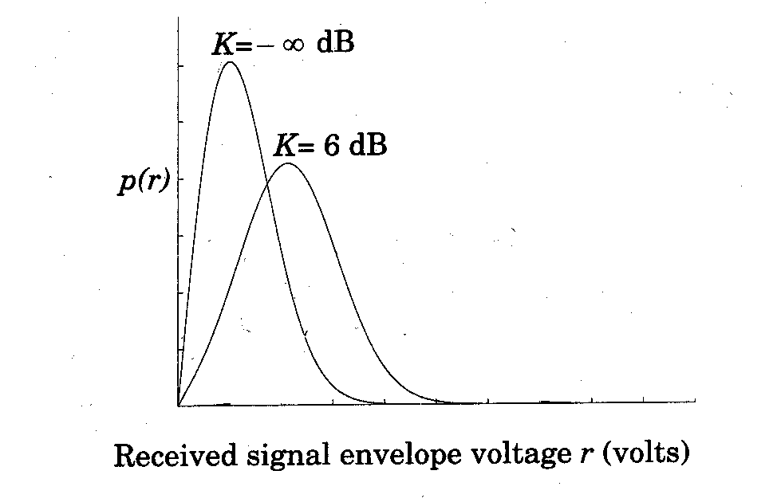
The parameter K is known as the Ricean factor and completely specifies the Ricean distribution.
As , we have dB. The dominant path decrease in amplitude, the Ricean distribution degenerates to a Rayleigh distribution.

Slide 53
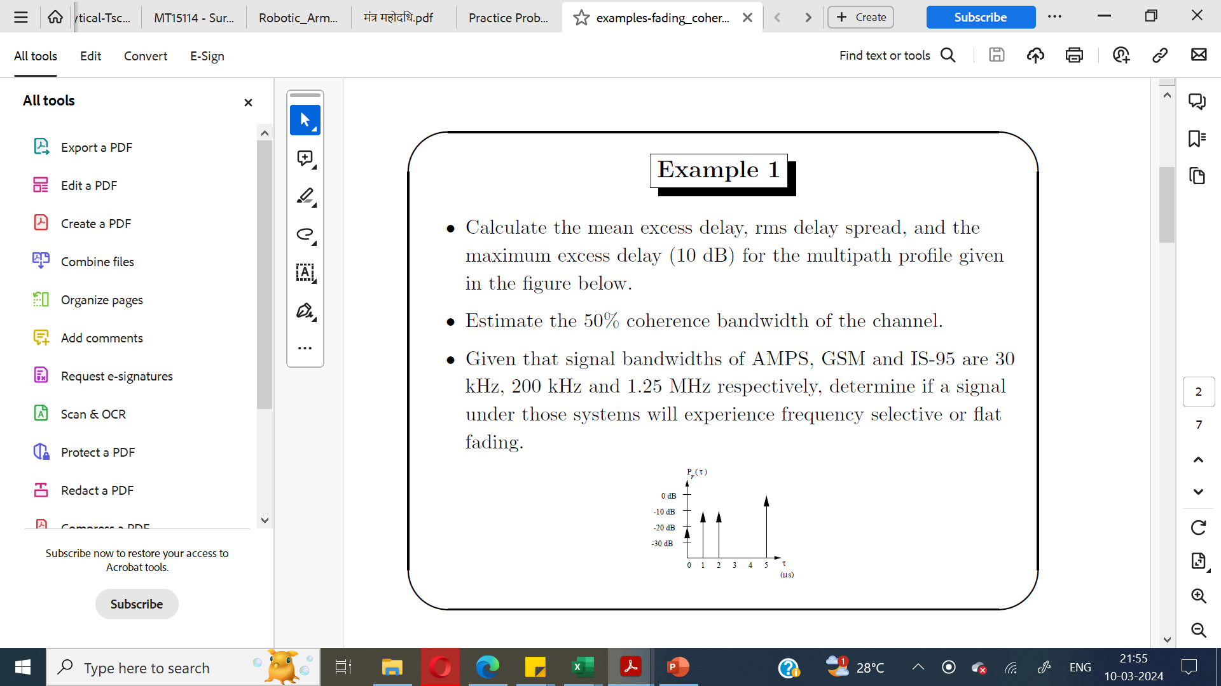

Slide 54
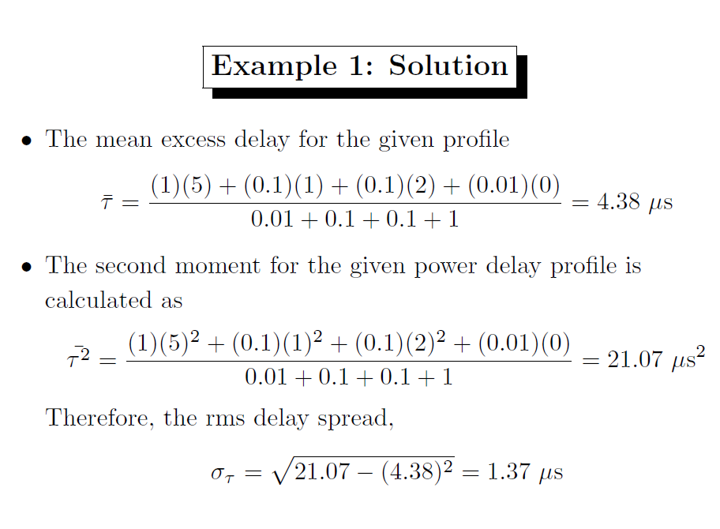

Slide 55
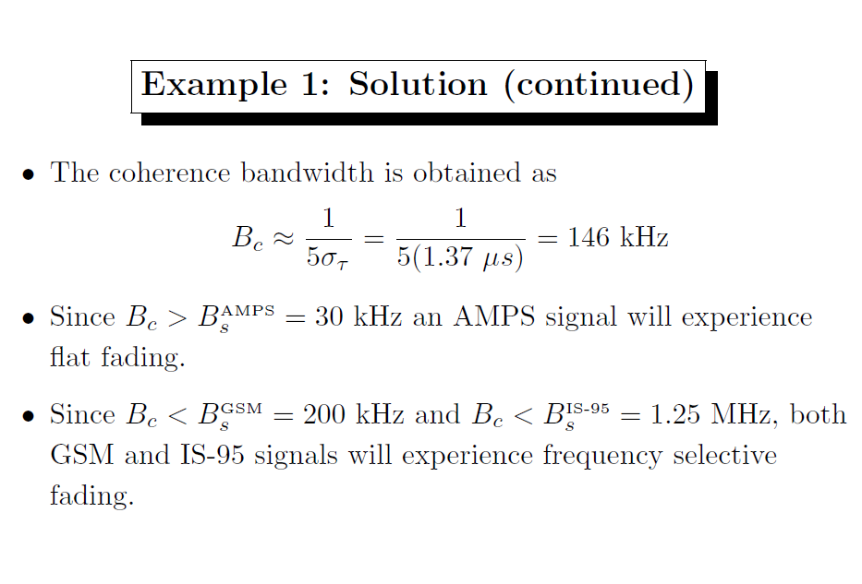

Slide 56
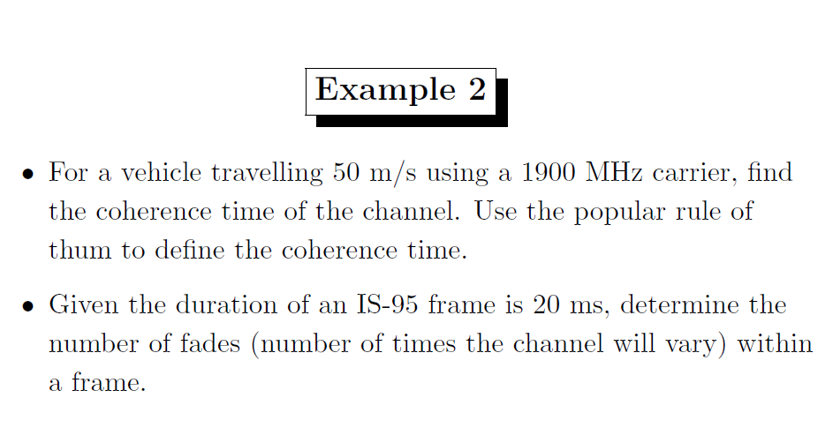

Slide 57
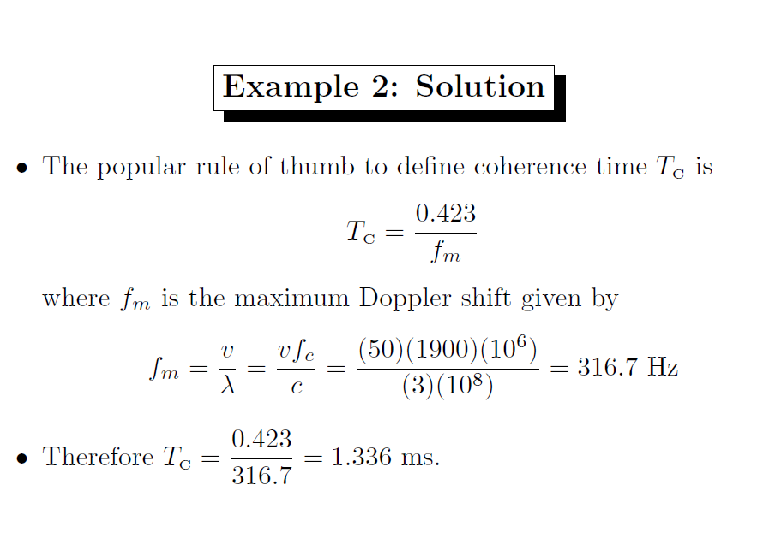

Slide 58
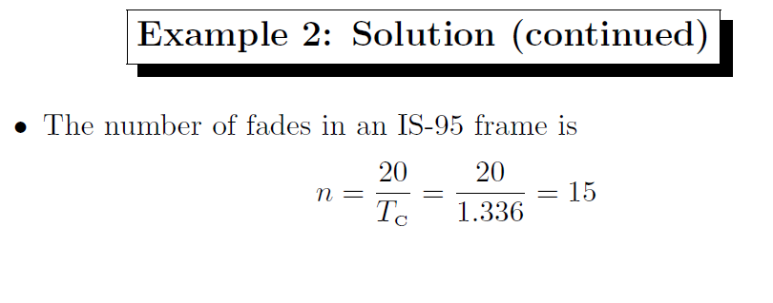

Slide 59
Parameters of a Rayleigh Fading Channel
Level Crossing Rate
Fade Rate
Average Fade Duration

Slide 60
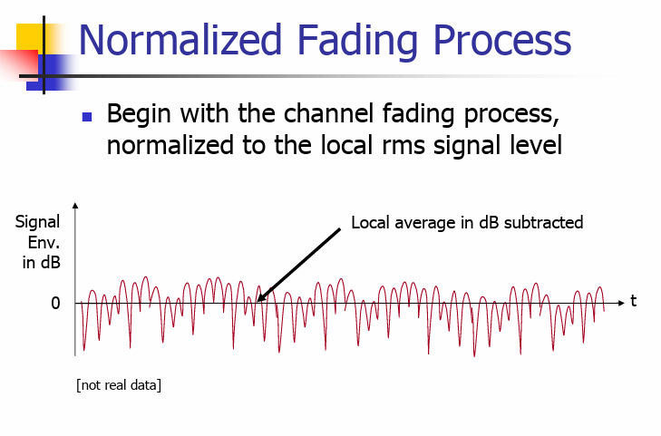

Slide 61
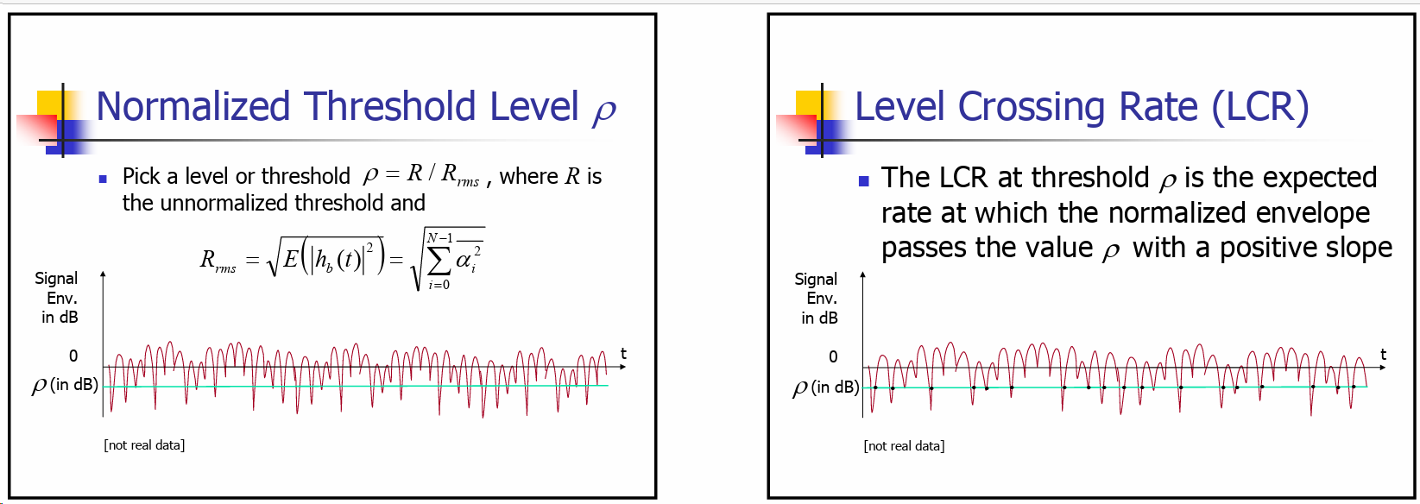

Slide 63
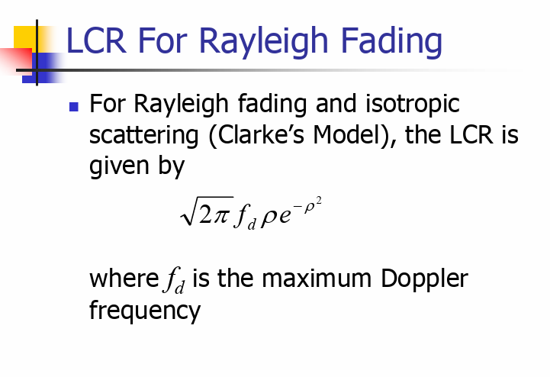

Slide 64
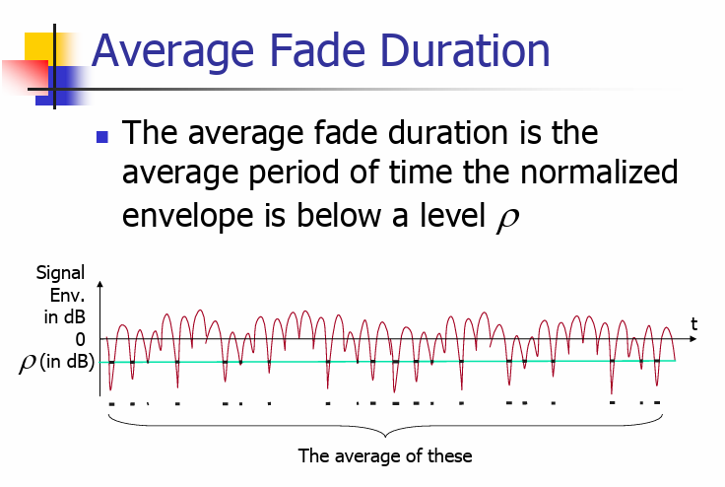

Slide 65
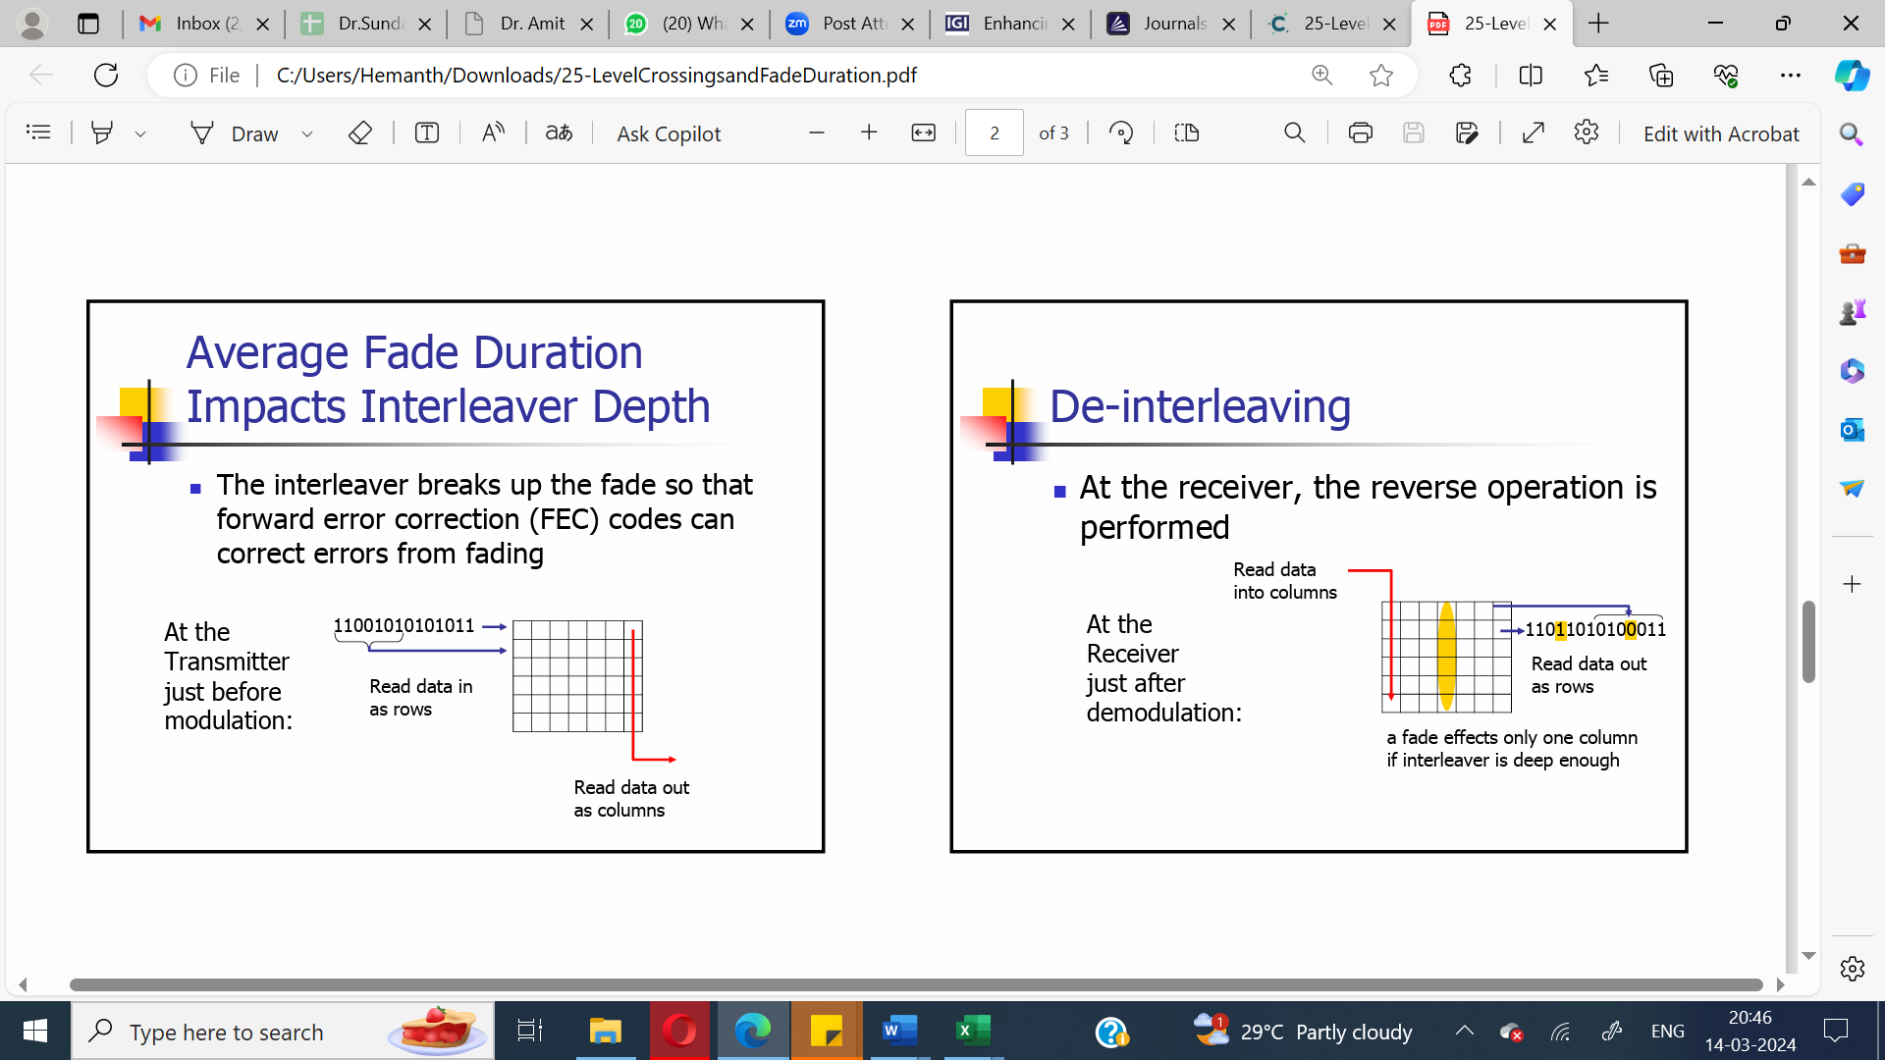

Slide 67
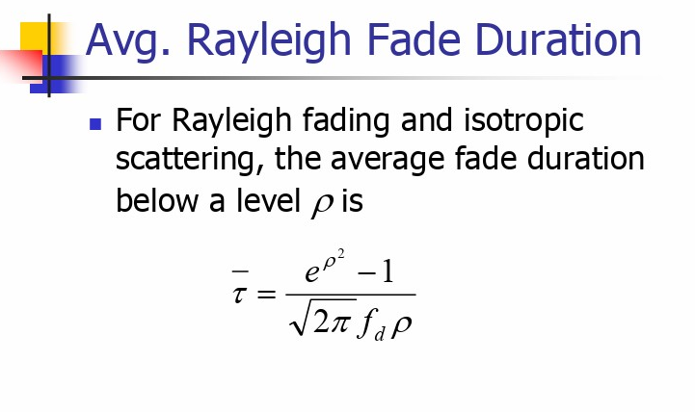

Slide 68
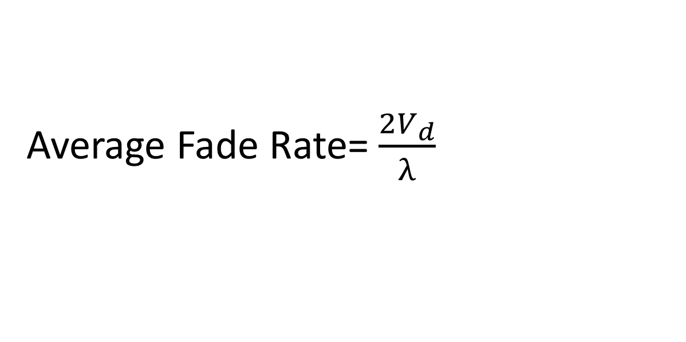
Average Fade Rate= $\frac{2V_{d}}{λ}$

Slide 69
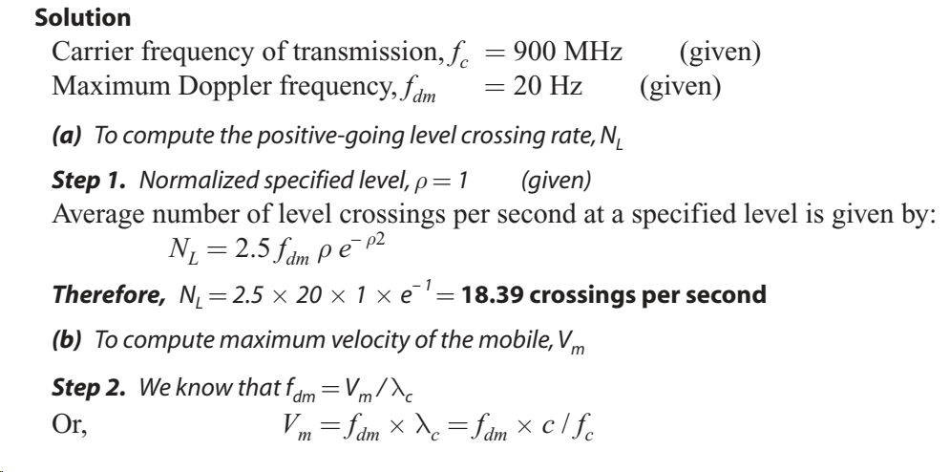
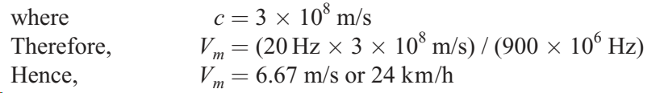
Consider a Rayleigh fading signal experiencing a maximum Doppler frequency of 20 Hz. The carrier frequency is 900 MHz. Compute (a) the positive-going level-crossing rate for ρ = 1 (b) maximum velocity of the mobile for the given Doppler frequency

Slide 70
Assume that a bit error occurs whenever any portion of a bit encounters a fade for which ρ < 0.1. For a given maximum Doppler frequency of 20 Hz,
(a) What is the average fade duration for threshold levels ρ = 0.01,ρ = 0.1,ρ = 0.707, and ρ = 1?
(b) For a binary digital modulation with a data rate of 50 bps, is the Rayleigh fading slow or fast corresponding to ρ = 0.707?
(c) What is the average number of bit errors per second for the given data rate of 50 bps?

Slide 71
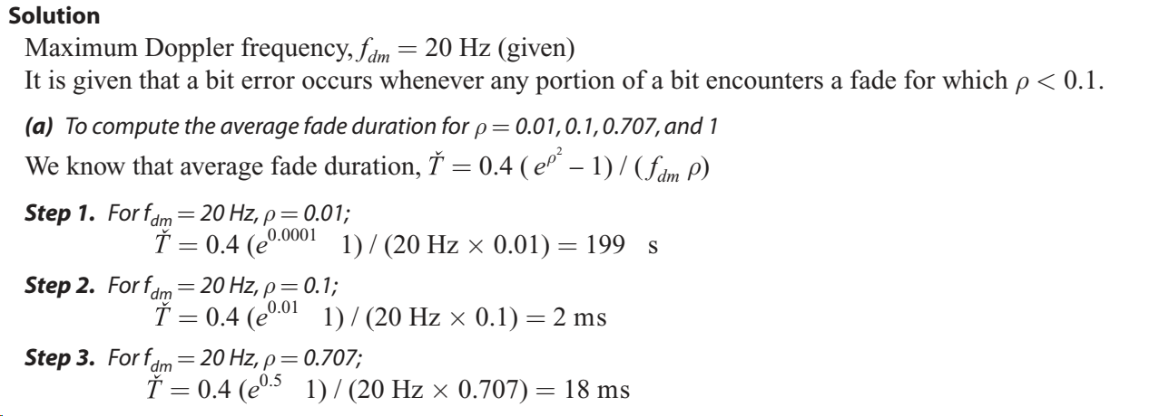

Slide 72
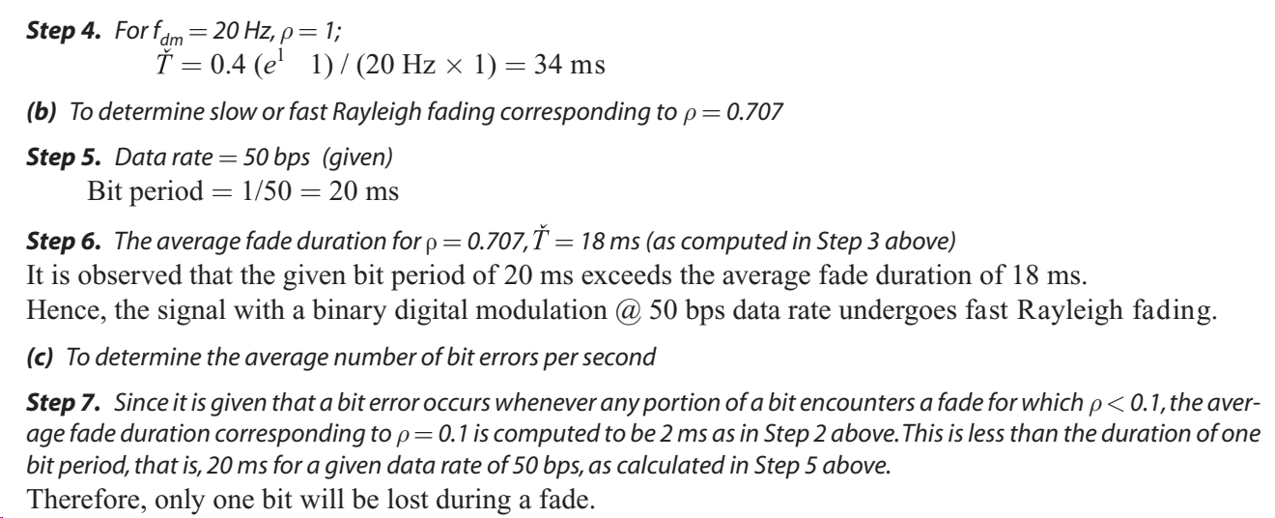

Slide 73
